Slide 1
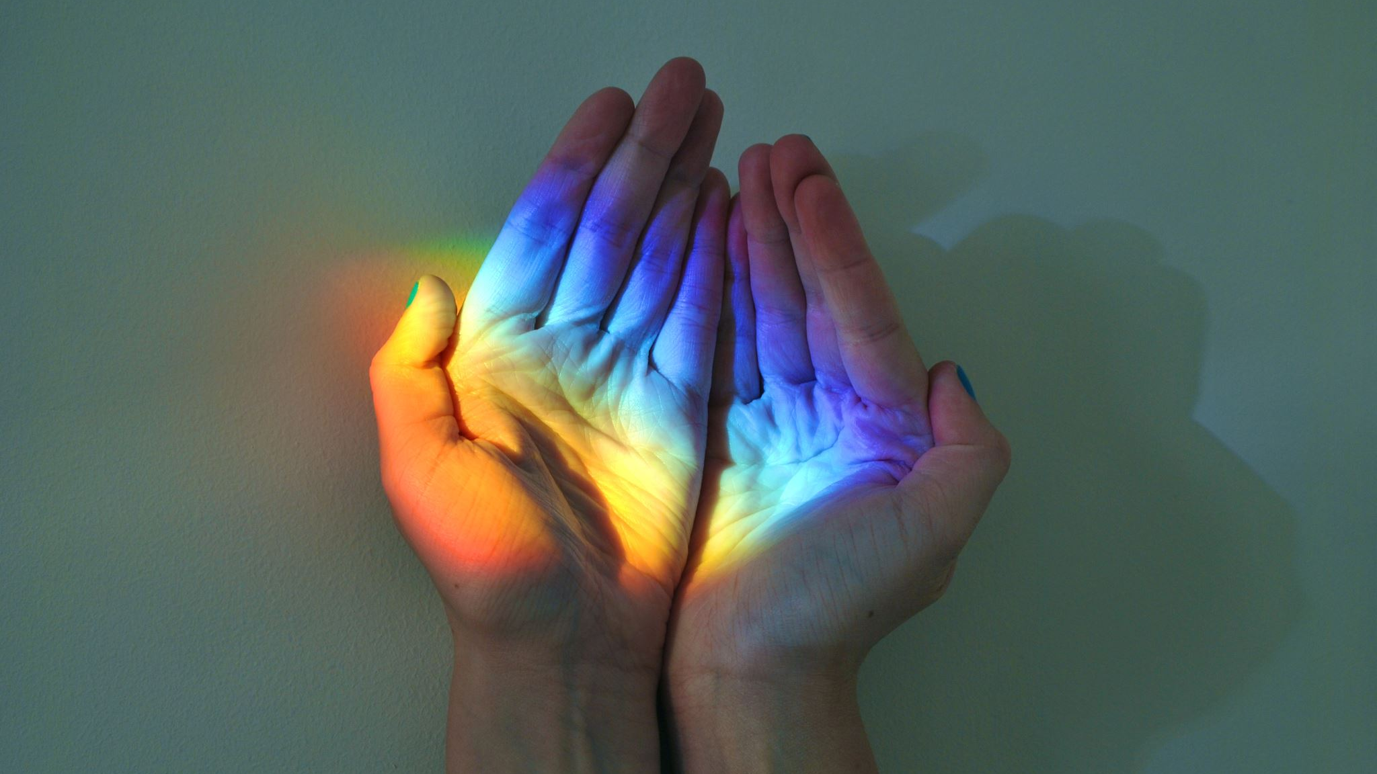
Cartoonizing Images (Toon It!)
Mazen Mobtasem 18100142
Kareem Mohamed 18102478 Abdelaziz Hossam ElDin 18100642

Slide 2

Table of contents
Target
Tools
Process
Result
Optimization

Slide 3
Target
Adding a filter for images that allows it to look “Cartoonish”

Slide 4
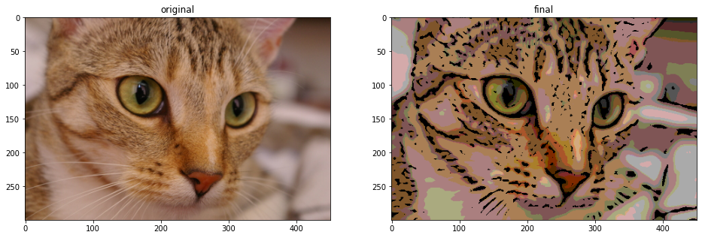
Target

Slide 5
Tools Used
Numpy
Matplotlib.pyplot
Scipy
Skimage
CV2
PIL

Slide 6
Process
Turning RGB image to grayscale to allow the ease of edge extraction to outline the main object in the picture.
Thresholding the image to further visualize the edge extraction.
Dilating the output of thresholding to “smoothen” the edges producing the final mask that will be used in the AND operator.
Blurring and Quantizing the RGB Image to be used for the AND operator for the result.
Using the smoothed edge mask and RGB Quantized Image in the AND Operator to produce the “Cartooned Image”

Slide 7
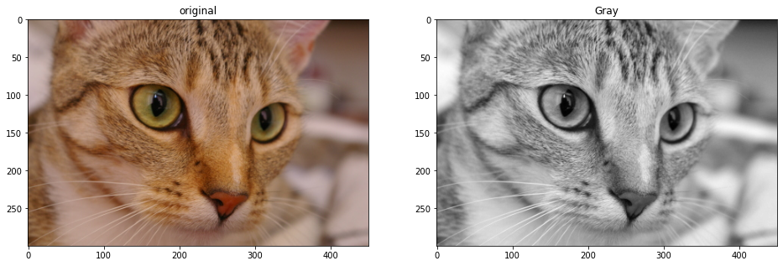
Original to gray
Using the following formula to turn the image gray: gray = 0.2989 * Red + 0.5870 * Green + 0.1140 * Blue

Slide 8
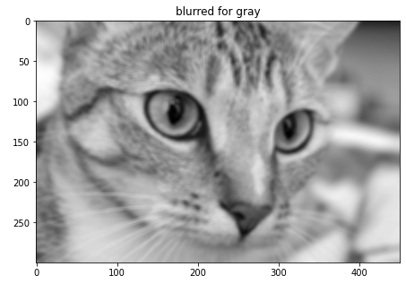
Blurring Gray Image
Convolution of the image using a mean filter kernel which is dynamically sized (i.e. can be inputted by the user).

Slide 9
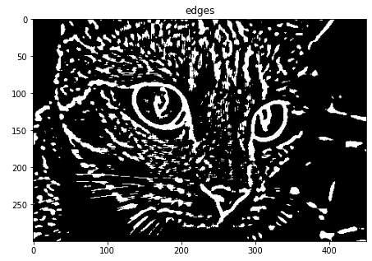
Extracting edges
By the Convolution of the blurred gray with a la place edge kernel.

Slide 10
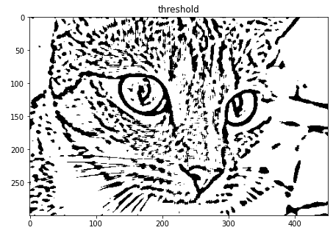
Thresholding
Thresholding the edged output to further highlight the edges.

Slide 11
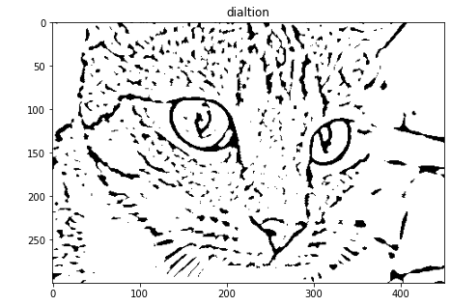
Dilatate edges
Smoothening the edges by using dilation.

Slide 12
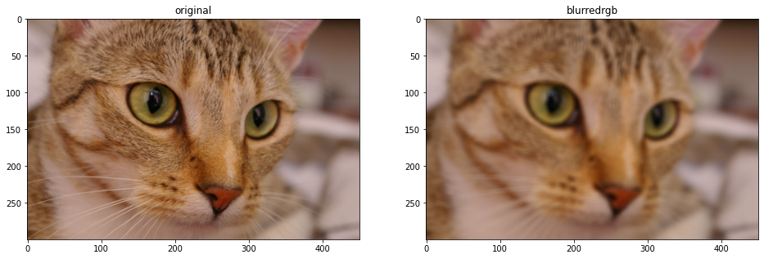
Blurring RGB Image
Convolution of the RGB image using the same mean kernel was used on the gray image.

Slide 13
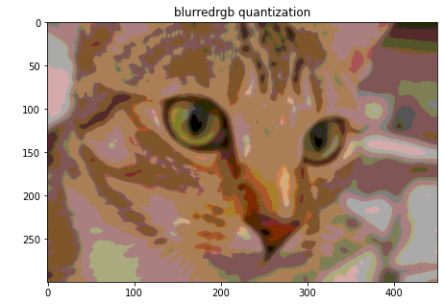
Quantization
Reducing the intensity of the colors in the blurred image using quantization to create a “Toon” effect.

Slide 14
AND Operator
Which will produce the final required result.

Slide 15

Result

Slide 16
Cartooned Image

Slide 17
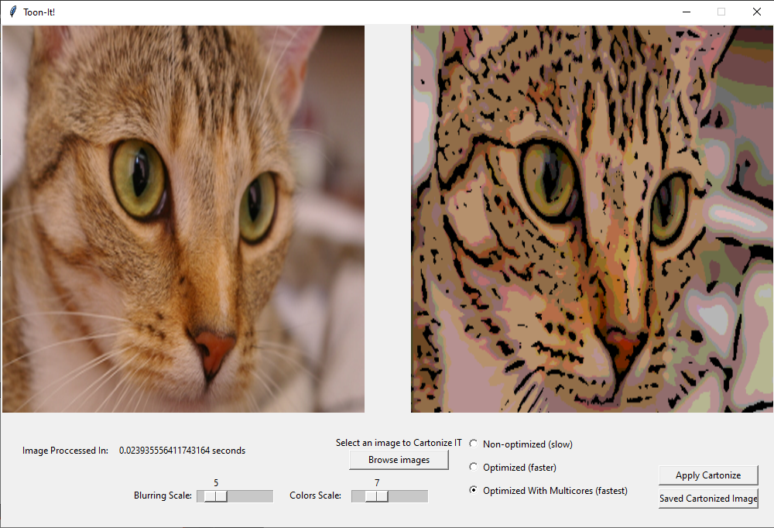
Graphical user interface

Slide 18
Optimization
Using Numba library to compile the code as soon as the program starts pre-usage to further increase the speed of execution when running.
Using Multicores to additionally enhance the speed of the production of the Image
Further explanation will be demonstrated in the demo.

Slide 19
Future Work
Using AI based system to scan the image and find the best possible kernel size and color intensity values for best possible production of the Cartooned Image.

